Slide 1
Visualizing Song Popularity and Genre Trends in Modern Music
Goal: Use Tableau to explore patterns in song features, artist popularity, genre distribution, and lyrical content.
Group 5
Group member : Yiyang lin, Yingshen ye, junyan dong

Slide 2
Dataset Description
Source: Pre-cleaned music dataset with 2000 rows and 18 variables
Key Columns:
Artist, Song, Year, Genre, Popularity, Duration (ms)
Audio features: Danceability, Energy, Loudness, Speechiness, Acousticness, etc.
Explicit content, Tempo, Mode, Instrumentalness, Liveness, Valence

Slide 3
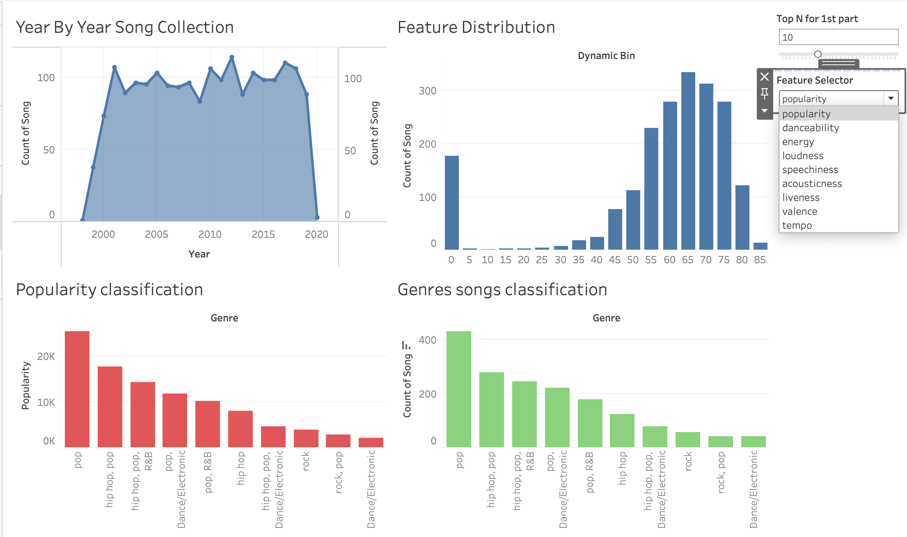
Dashboard 1 - Feature Distribution & Classification
Purpose:
Understand how song characteristics and genres contribute to popularity
Views Shown:
Year-by-Year Song Count: Trend of song releases (peak around 2000–2020)
Dynamic Feature Distribution: Histogram by selected audio feature (e.g., popularity, danceability)
Popularity Classification by Genre: Pop and Hip-Hop dominate popularity
Genre Song Count: Pop has the largest volume of songs overall
Interactive Controls:
Parameter: Top N for 1st part — used to control popularity classification chart and Genres songs classification chart dynamically

Slide 4
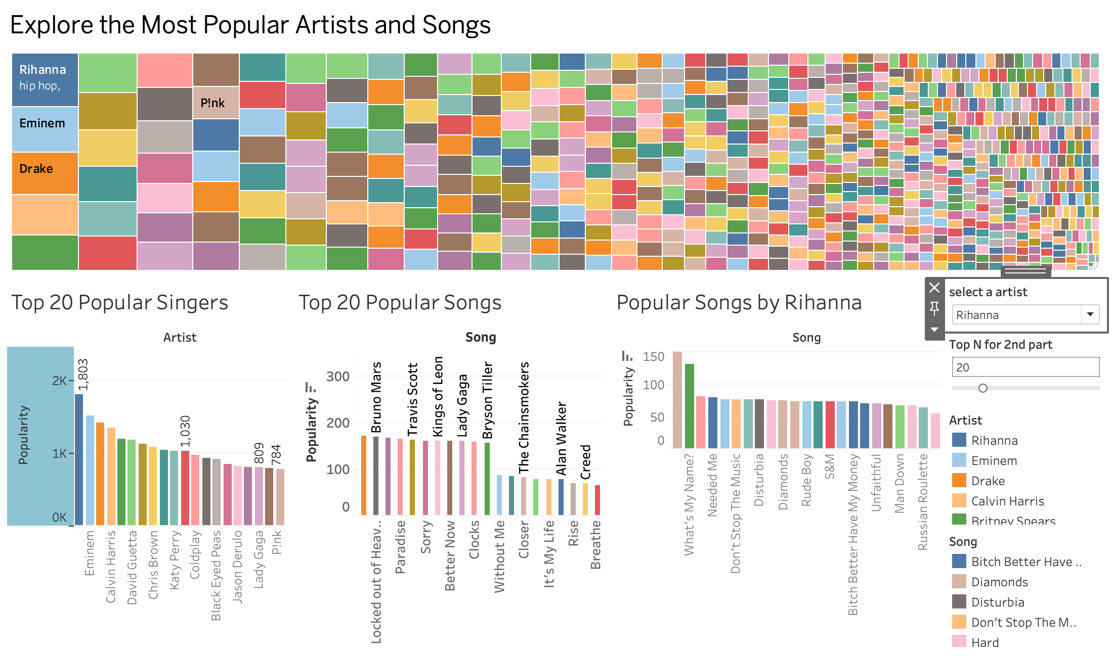
Dashboard 2 - Artist and Song Exploration
Purpose:
Discover artist impact and song-level performance across the dataset
Views Shown:
Treemap of Artists by Popularity: Block size based on total popularity
Top N Artists: Bar chart driven by popularity
Top N Songs (Unique by Song): Most popular single version per title
Popular Songs by Selected Artist: Filters down to top songs by selected artist
Interactive Features:
Parameter: Top N for 2nd part — adjusts the number of artists/songs shown
Parameter: select a artist — dynamically changes the rightmost chart
Highlight Actions — hovering over any chart highlights relevant elements across all charts

Slide 5
Dashboard 3 - Explicit Content Analysis

Slide 6
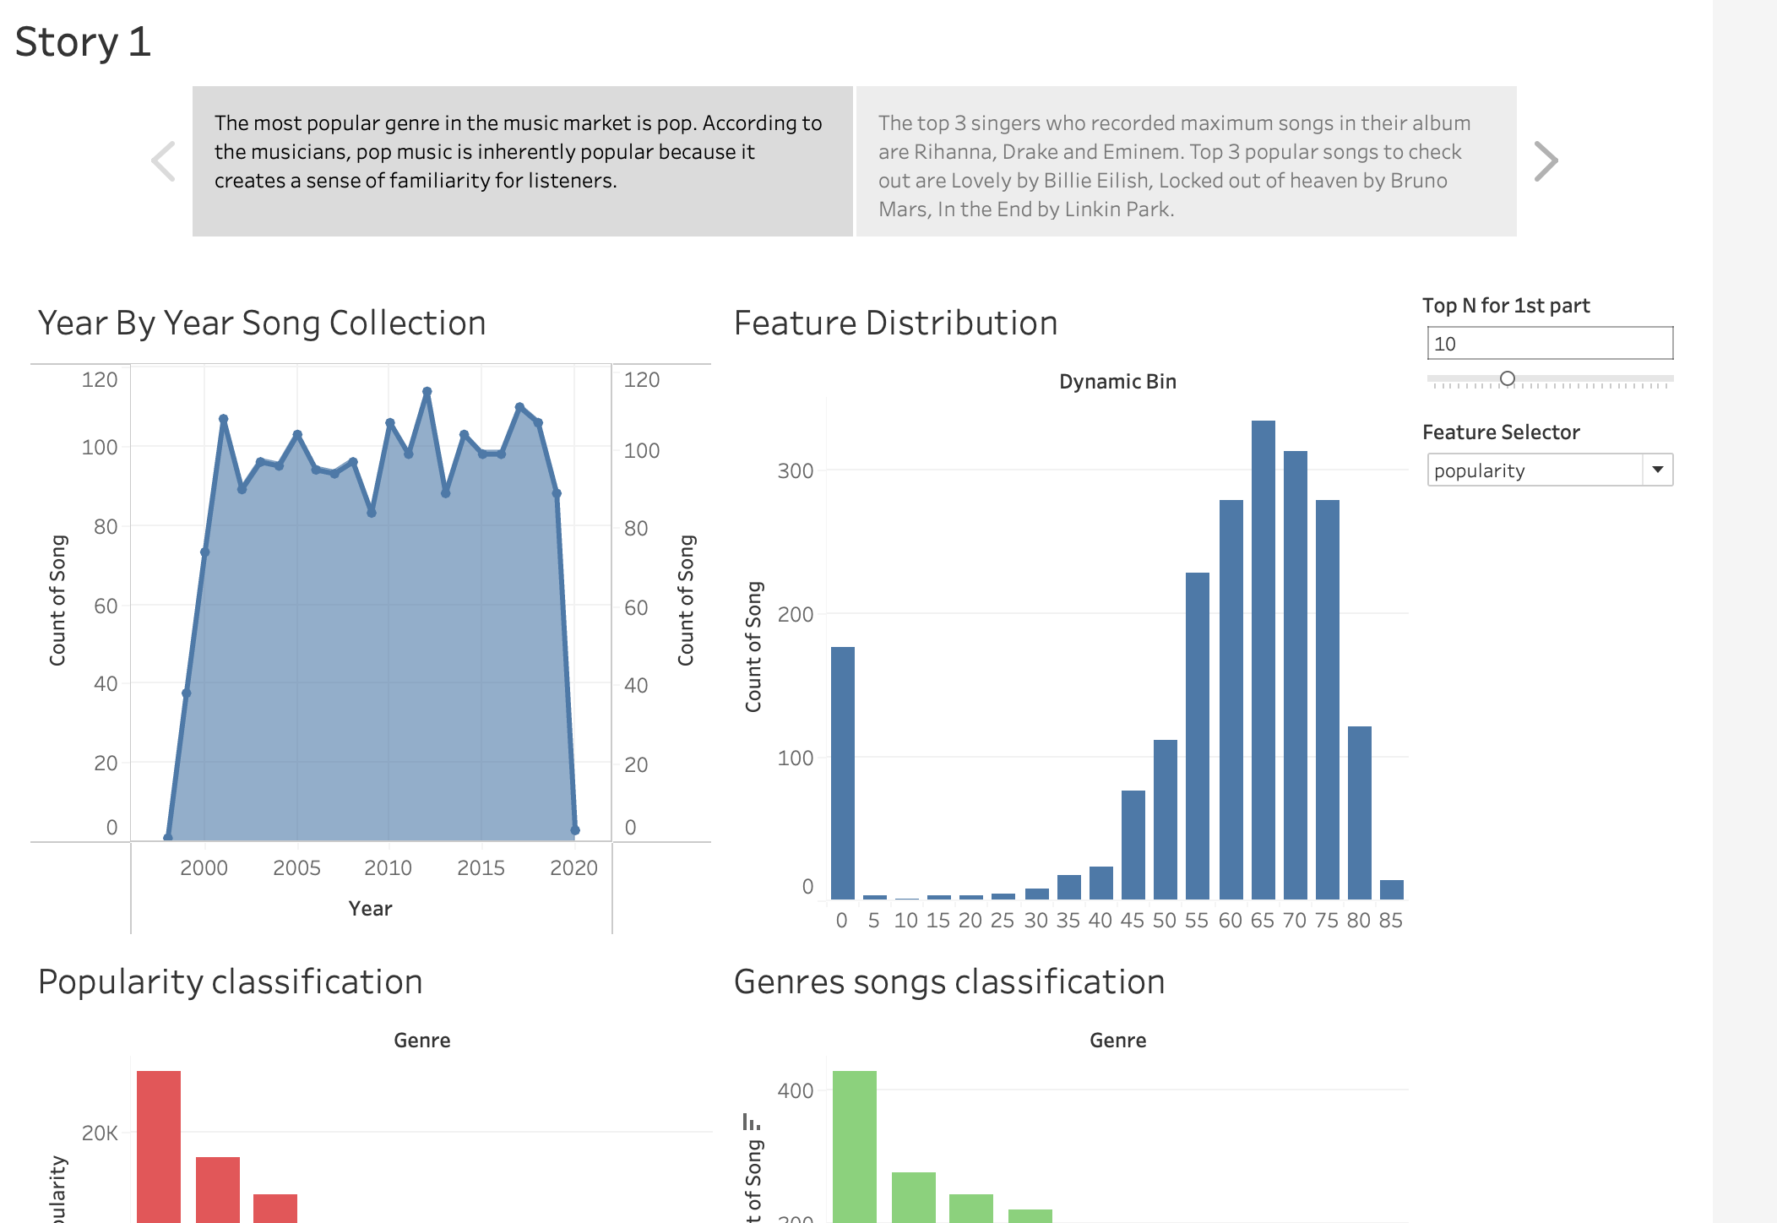
Story Points Considered
Dashboard 1 - Genre Dominance: The most popular genre in the music market is pop. According to musicians, pop music is inherently popular because it creates a sense of familiarity for listeners.
Dashboard 2 - Top Artists and Songs: The top 3 singers who recorded the most songs are Rihanna, Drake, and Eminem. The top 3 most popular songs are Lovely by Billie Eilish, Locked Out of Heaven by Bruno Mars, and In the End by Linkin Park.
[To be completed — Dashboard 3
The pic should be replaced(completed version)]

Slide 7
Key Insights & Recommendations
Dashboard 1:
Pop and Hip-Hop dominate popularity and volume
Dashboard 2:
Many songs share names; only a few versions are truly popular
Popularity often comes from a small number of breakout songs per artist
Dashboard 3: (to be completed)
Explicit songs tend to have slightly higher popularity on average
Interactive dashboards and parameter controls empower deeper user insight

